Slide 1
MSc Artificial Intelligence
Knowledge Engineering
Week 2, 18-20 November 2024
Notes:
This colour bar is to be used for Artificial Intelligence

Slide 2
A look back at knowledge bases
Knowledge Bases provide one means of representing our knowledge of the world
Robust mechanisms for querying
Can produce new knowledge (new sentences)
Easily updated
Rigourous inference
Human readable in principle

Slide 3
Limitations of Knowledge Bases
Not scalable
Labour intensive
Relationships not especially transparent
No “types”
No annotations

Slide 4
Overcoming these Limitations
There are many things we would like KB to do:
Explicitly model relationships between entities
Allow the “atomic units of knowledge” to be annotated with additional information
Support performant and accurate inference
Scale to very large numbers of “atoms”.
Support highly parallel querying
Interpretable by humans
Readable by machines
Enter the knowledge graph

Slide 5
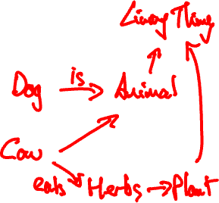
Rule-based systems as graphs
If x is a dog then x is an animal.
If x is a cow then x is an animal.
If x is an animal then x is a living thing.
If x is a cow then x eats herbs.
If x is a herb then x is a plant.
If x is a plant then x is a living thing.
What does the graph miss?

Slide 6

What is a Knowledge Graph
A Knowledge Base, structured on a graph
Defines the “things” that our knowledge is about – the nodes of the graph
Defines the relationships between the “things’” – the edges of the graph
Defines the properties of the “things” – the attributes of the nodes
Rich structure, often with substructure (clustering of nodes)
Normalised
Explicit and declarative – has an intended meaning and is itself meaningful
Often large – millions of nodes or more
Human and machine readable

Slide 7
A simple example
Obeys a “grammar”
Relationships are explicitly defined
Loose hierarchy defined by the relationships, not imposed
Nodes can be directly annotated
Normalised
Has a clear meaning
https://commons.wikimedia.org/wiki/File:Conceptual_Diagram_-_Example.svg licensed under the Creative Commons Attribution-Share Alike 4.0 International license.

Slide 8
A More Complex Example
How might you model the relationships between:
Me, Lu Bai, Hui Wang
All of you (A. Turing, G. Hopper)
Knowledge Engineering, Machine Learning, Into to AI modules
What nodes do we need?
What relationships do we need to define?

Slide 9
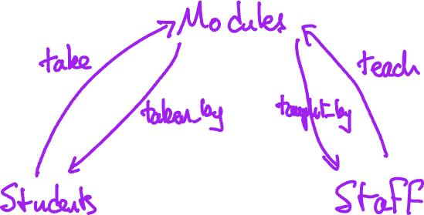

Exercises 9: A simple knowledge graph

Slide 10
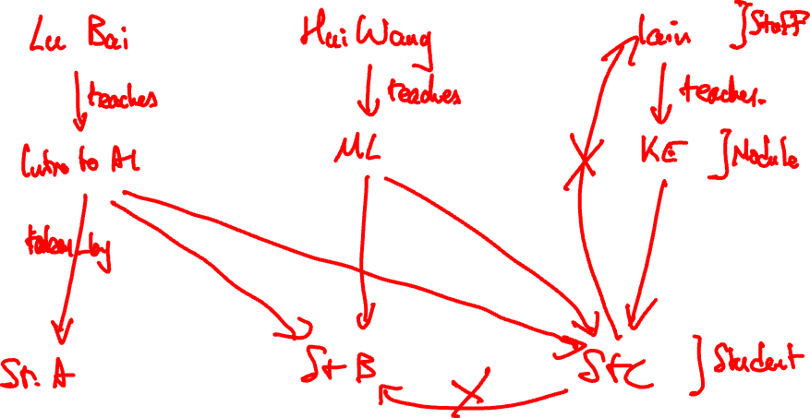

Slide 11
MSc Artificial Intelligence
Knowledge Engineering
Week 2, 18-20 November 2024
Notes:
This colour bar is to be used for Artificial Intelligence

Slide 12
What can Knowledge Graphs do?
Explicitly model relations between things
Model relations between classes of things
Model hierarchies of things
Be used to identify patterns
Be used directly to derive new knowledge by running logical inference on top of a knowledge graph

Slide 13

What’s wrong with a Relational DB?
All of this could be done with a SQL database
The information is there, but it is hardly transparent
Information spread over many tables
Not really human readable
uid (PK) | staffID | Name
1 | 12345 | Iain Styles
2 | 54321 | Hui Wang
3 | 12321 | Lu Bai
uid (PK) | moduleID | Name | Taught By
11 | 45678 | Knowledge Engineering | 12345
12 | 56789 | Machine Learning | 54321
33 | 67890 | Intro to AI | 12321

Slide 14

Why Graphs?
Graphs are a natural way of representing relationships
“Things” = vertices on the graph
“Relationships” = edges on the graph
Rich mathematical structure entail many powerful algorithms
Totally flexible abstract data structure and can be structured to model
Useful to have in mind some basic properties of graphs

Slide 15
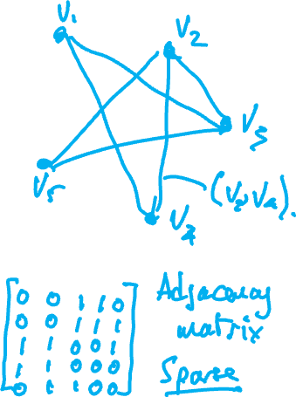
Graph Basics
A graph consists of a set V of nodes or vertices and a set E of edges
Each edge is a tuple of two vertices
Vertices v₁ and v₂ are adjacent (ie, connected) if (v₁, v₂) is in E
Edges can be directed
Can represent in terms of matrices

Slide 16
How to structure graphs
Graphs provide a powerful mathematical foundation
But we need to structure them to model a specific problem
Specifically, we need to decide what features of a problem a graph should represent
And what relationships it should include.
This can be specified by an ontology

Slide 17
Ontologies
An Ontology is a formal way of specifiying the “things” in a domain, their properties, and the relationships between them.
It is a schema for modelling the problem
Derived from domain knowledge
Knowledge graphs are structured according to an ontology
Specific facts/data are then instantiated

Slide 18
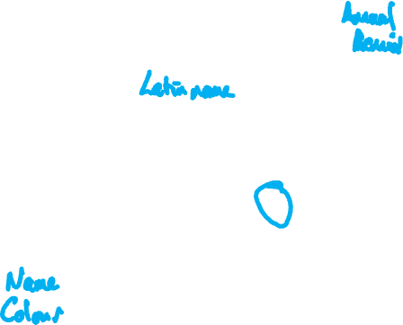
Steps in creating an ontology
Define the entities – the fundamental concepts in the domain?
What are the relationships between the entities?
What properties do the entities have?
https://commons.wikimedia.org/wiki/File:Conceptual_Diagram_-_Example.svg licensed under the Creative Commons Attribution-Share Alike 4.0 International license.

Slide 19
Entities
What are the fundamental concepts?
Living things?
Animals?
Plants?
Dogs?
Cows?
Herbs?
It depends…
is
is
https://commons.wikimedia.org/wiki/File:Conceptual_Diagram_-_Example.svg licensed under the Creative Commons Attribution-Share Alike 4.0 International license.
Great Dane
Chihuahua

Slide 20
Relationships
What are the fundamental relations between entities?
Is? (belongs to)
Eats?
Is toxic to?
Are relationships meaningfully bidirectional?
It depends…
is
is
https://commons.wikimedia.org/wiki/File:Conceptual_Diagram_-_Example.svg licensed under the Creative Commons Attribution-Share Alike 4.0 International license.
Great Dane
Chihuahua

Slide 21
Properties
What are the fundamental properties of the entities?
Latin name?
Typical size?
Where it is found?
It depends…
is
is
https://commons.wikimedia.org/wiki/File:Conceptual_Diagram_-_Example.svg licensed under the Creative Commons Attribution-Share Alike 4.0 International license.
Great Dane
Chihuahua

Slide 22
Ontology Guidelines
Does not need to represent everything we know
Not all relationships will matter
Not all properties will be important
Is the colour of a tablet relevant?
No, if you are a doctor or a patient
Yes, if you are responsible for manufacturing it

Slide 23
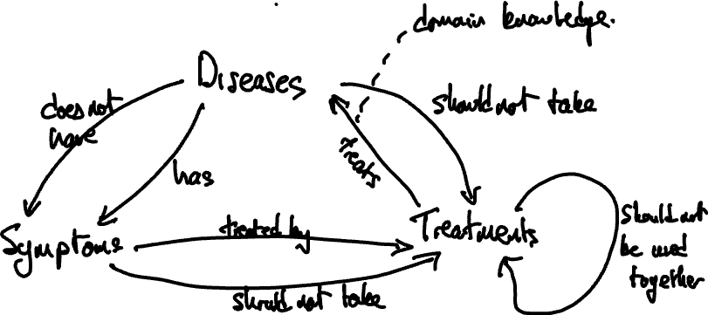
Exercises 10: Designing an Ontology

Slide 24
MSc Artificial Intelligence
Knowledge Engineering
Week 2, 18-20 November 2024
Notes:
This colour bar is to be used for Artificial Intelligence

Slide 25
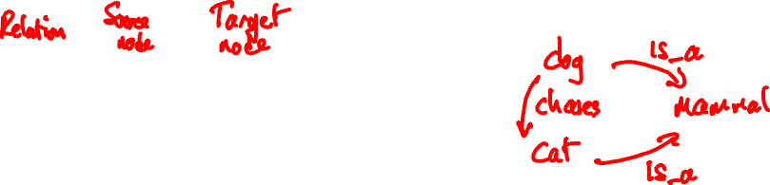
Examples of different ontology formats
(is_a, dog, mammal)
(is_a, cat, mammal)
(chases, dog, cat)
Simple Triples format
Easy to parse
Portable
Lacks metadata
Extensible

Slide 26
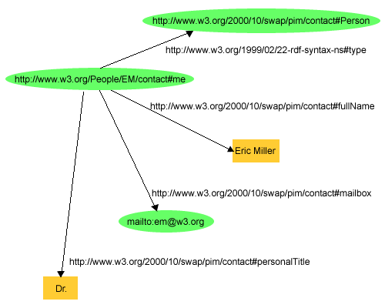
Examples of different ontology formats
<http://www.w3.org/People/EM/contact#me> <http://www.w3.org/1999/02/22-rdf-syntax-ns#type> <http://www.w3.org/2000/10/swap/pim/contact#Person> .
<http://www.w3.org/People/EM/contact#me> <http://www.w3.org/2000/10/swap/pim/contact#fullName> "Eric Miller" .
<http://www.w3.org/People/EM/contact#me> <http://www.w3.org/2000/10/swap/pim/contact#mailbox> <mailto:em@w3.org> .
<http://www.w3.org/People/EM/contact#me> <http://www.w3.org/2000/10/swap/pim/contact#personalTitle> "Dr." .
W3C N-Triples format
Subject– Predicate – Object
Designed for web data
Referenced against external W3C definitions
http://www.w3.org/TR/rdf-primer/fig1dec16.png

Slide 27
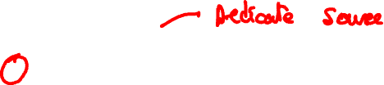
Turtle: Terse RDF Triple Language
prefix ns0: <http://www.w3.org/2000/10/swap/pim/contact#> .
http://www.w3.org/People/EM/contact#me a <http://www.w3.org/2000/10/swap/pim/contact#Person> ;
ns0:fullName "Eric Miller" ;
ns0:mailbox <mailto:em@w3.org> ;
ns0:personalTitle "Dr." .
Less repetitive and verbose than N-Triples
Namespaces and nesting

Slide 28
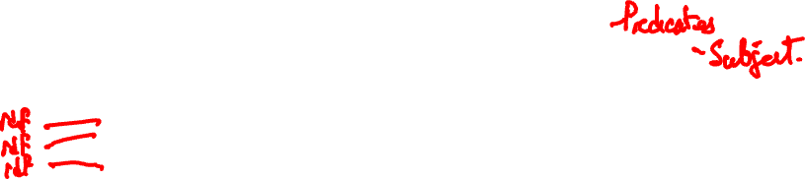
RDF/XML
<?xml version="1.0"?>
<rdf:RDF xmlns:rdf="http://www.w3.org/1999/02/22-rdf-syntax-ns#"
xmlns:contact="http://www.w3.org/2000/10/swap/pim/contact#">
<contact:Person rdf:about="http://www.w3.org/People/EM/contact#me">
<contact:fullName>Eric Miller</contact:fullName>
<contact:mailbox rdf:resource="mailto:em@w3.org"/>
<contact:personalTitle>Dr.</contact:personalTitle>
</contact:Person>
</rdf:RDF>
Very similar but a little more verbose than Turtle
XML-based so can use generic parsers

Slide 29
OWL: Web Ontology Language
<?xml version="1.0"?>
<rdf:RDF xmlns:rdf="http://www.w3.org/1999/02/22-rdf-syntax-ns#"
xmlns:xsd="http://www.w3.org/2001/XMLSchema#"
xmlns:rdfs="http://www.w3.org/2000/01/rdf-schema#"
xmlns:owl="http://www.w3.org/2002/07/owl#"
xml:base="http://www.dummy.info/new.owl"
xmlns="http://www.dummy.info/new.owl#">
<owl:Ontology rdf:about="http://www.dummy.info/new.owl"/>
<owl:Class rdf:about="#Animal">
<rdfs:subClassOf rdf:resource="http://www.w3.org/2002/07/owl#Thing"/>
</owl:Class>
<owl:Class rdf:about="#Dog">
<rdfs:subClassOf rdf:resource="http://www.w3.org/2002/07/owl#Thing"/>
</owl:Class>
<owl:Class rdf:about="#Cat">
<rdfs:subClassOf rdf:resource="http://www.w3.org/2002/07/owl#Thing"/>
</owl:Class>
<owl:ObjectProperty rdf:about="#is_a">
<rdfs:domain rdf:resource="#Dog"/>
<rdfs:range rdf:resource="#Animal"/>
</owl:ObjectProperty>
<owl:ObjectProperty rdf:about="#is_a">
<rdfs:domain rdf:resource="#Cat"/>
<rdfs:range rdf:resource="#Animal"/>
</owl:ObjectProperty>
<owl:ObjectProperty rdf:about="#chases">
<rdfs:domain rdf:resource="#Dog"/>
<rdfs:range rdf:resource="#Cat"/>
</owl:ObjectProperty>
</rdf:RDF>
Like many XML formats, can be very verbose.
XML tooling.
Referenced against external definitions.

Slide 30
Notes on formats
Ontology representations designed to be “human readable” and machine parseable.
In practice, nearly always read/written by tools and read by humans only when strictly necessary.

Slide 31
MSc Artificial Intelligence
Knowledge Engineering
Week 2, 18-20 November 2024
Notes:
This colour bar is to be used for Artificial Intelligence

Slide 32
How do we specify an ontology?
Web Ontology Language (OWL)
We’ll study this by example later
We do not write this by hand: use a tool: https://owlready2.readthedocs.io/en/v0.42/
conda install -c conda-forge owlready2
Let’s code…

Slide 33
Exercises 11: Designing an Ontology

Slide 34
Where to find out more?
There is a lot more you can do
I found all of the following helpful
https://owlready2.readthedocs.io/en/v0.42/
https://kgtutorial.github.io/
https://jingdongsun.medium.com/creating-knowledge-graph-step-by-step-a383231acf2d
https://iccl.inf.tu-dresden.de/web/Knowledge_Graphs_(WS2021)/en

Slide 35
Exercises 12: Implementing a Complete Ontology

